Slide 1



CMR COLLEGE OF ENGINEERING & TECHNOLOGY
Kandlakoya, Medchal, Hyderabad - 501401
Department of Computer Science and Engineering
PATIENT STABILITY PREDICTION USING MACHINE LEARNING
BATCH-03
NAME OF THE STUDENT & ROLL NO:
G. ARCHITH KUMAR - 19H51A05D5
MOHD IFTEQUARUDDIN - 19H51A05E0
R. ROHITH REDDY - 19H51A05E8
Under Esteemed Guidance Of
MAJOR Dr. V.A. NARAYANA – PROFESSOR & PRINCIPAL

Slide 2
CONTENTS
Abstract
Introduction
Literature Review
Existing System
Problems in existing system
Research Objective of Presentation
Problem Definition
Research Work
Proposed system architecture
Methods
Comparison of proposed system with an existing system
Results
Conclusion
Future Work
References
Notes:
2

Slide 3

Abstract
Notes:
3

Slide 4
ABSTRACT
These years, with artificial intelligence and machine learning becoming the hotspot of research, several applications have emerged in each of these areas. It exists not only as a kind of academic frontier but also something close to our life. In this trend, the combination of medical care and machine learning becomes more and more tighter. The proposal of its main idea also greatly alleviated the existing situation of unbalanced medical distribution and resources strain.
This summarizes some application of machine learning and auxiliary tumour treatment in the process of medical resource allocation and puts forward some new methods of application to realize it closer to human life in the era of artificial intelligence and the explores a good situation of mutual combination of medical industry and computer industry, which is benefit both.

Slide 5
INTRODUCTION
Notes:
5

Slide 6
INTRODUCTION
In today’s society, medical care problems have become a hot topic, and problems such as the unbalance and insufficient allocation of medical resources has become increasingly apparent. In this situation, the application of ML has become the unavoidable trend in the current development of medical care. As early as 1972, the scientists in the University of Leeds in the UK has been trying to use artificial intelligence (ANN) algorithms to judge abdominal pain. Now, more and more researchers are committed to the combination of ML and medical care. The methods of pathological diagnosis of tumors, lung cancer, etc. by ML has gradually entered the field of vision. Some companies, such as Alibaba, Amazon, and Baidu have established their own research team working for it.
This introduction of ML in medical care has greatly saved medical resources and provided a new way for citizens to see a doctor and facilitate people’s lives. At the same time, the demand of people also provides a new impetus for the research and development of ML, with promoting its continuous improvement.
Notes:
6

Slide 7
Literature Review

Slide 8
Detailed Study of Existing SYSTEM
1. Automatic Detection Of Cerebral Microbleeds From MR Images Via 3D Convolutional Neural Networks
Cerebral microbleeds (CMBs) are small haemorrhages nearby blood vessels. They have been recognized as important diagnostic biomarkers for many cerebrovascular diseases and cognitive dysfunctions.
In current clinical routine, CMBs are manually labelled by radiologists but this procedure is laborious, time-consuming, and error prone.
To further improve the detection performance while reducing the computational cost, They propose a cascaded framework under 3D CNNs for the task of CMB detection.

Slide 9
They first exploit a 3D fully convolutional network (FCN) strategy to retrieve the candidates with high probabilities of being CMBs, and then apply a well-trained 3D CNN discrimination model to distinguish CMBs from hard mimics.
Compared with traditional sliding window strategy, the proposed 3D FCN strategy can remove massive redundant computations and dramatically speed up the detection process. We constructed a large dataset with 320 volumetric MR scans and performed extensive experiments to validate the proposed method, which achieved a high sensitivity of 93.16% with an average number of 2.74 false positives per subject, outperforming previous methods using low-level descriptors or 2D CNNs by a significant margin.
LIMITATIONS:
This procedure is laborious, time-consuming, and error prone.
It consumes high cost.

Slide 10
2. Liver Segmentation From CT Images Using A Sparse Priori Statistical Shape Model (SP-SSM)
This study proposes a new liver segmentation method based on a sparse a priori statistical shape model (SP-SSM). First, mark points are selected in the liver a priori model and the original image.
Then, the a priori shape and its mark points are used to obtain a dictionary for the liver boundary information. Second, the sparse coefficient is calculated based on the correspondence between mark points in the original image and those in the a priori model, and then the sparse statistical model is established by combining the sparse coefficients and the dictionary.

Slide 11
Finally, the intensity energy and boundary energy models are built based on the intensity information and the specific boundary information of the original image.
Then, the sparse matching constraint model is established based on the sparse coding theory. These models jointly drive the iterative deformation of the sparse statistical model to approximate and accurately extract the liver boundaries.
LIMITATIONS:
The SP-SSM can achieve a mean overlap error.
Time taking process.
Unpredictable outcomes.

Slide 12
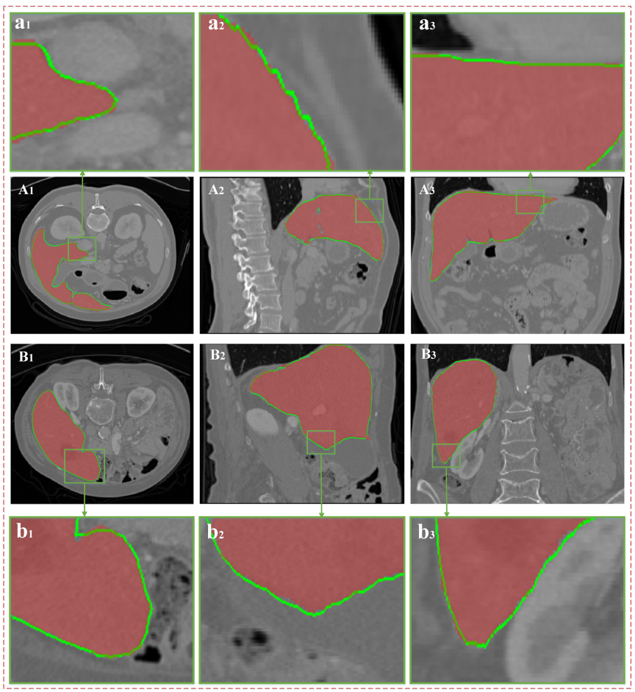
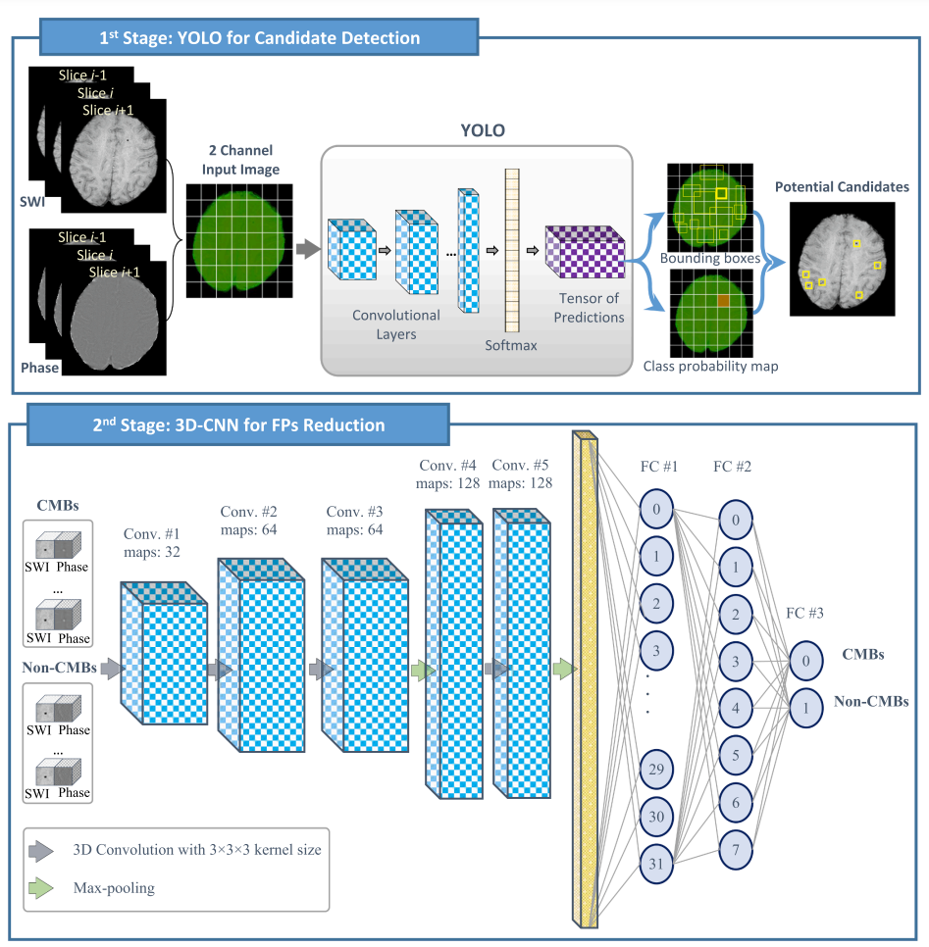
RESULTS OF EXISTING SYSTEM
Liver Segmentation Results.
Automatic Detection Of Cerebral Microbleeds.

Slide 13
COMPARISON OF EXISTING SOLUTIONS
Name Of The Existing Models | Liver Segmentation From CT Images | Automatic Detection Of Cerebral Microbleeds
Technologies Used | Computer Tomography | Magnetic Resonance Imaging
Algorithms Used | Sparse Priori Statistical Shape Model | 3D Convolutional Neural Networks
Problems | Can achieve a mean overlap error of 4.8%. Time taking process. | This procedure is laborious, time-consuming, high cost and error prone.
Challenges | One should over come the mean overlap error and Time-consuming process. And there are some un predictable results one should overcome that. | One should overcome Time-consuming process problem and reduce the cost. And the procedure also little complicated.

Slide 14
Research Objective

Slide 15
The adoption of the machine learning method means that simple work can be directly replaced by machines. It means that, at the same time, the employment situation of the relevant personnel and the education level of the medical profession need to be improved.
If we want to make sure that the patient's condition is as correct as possible, you must first ensure that we have a database that covers as much relevant information as possible, create a target data set, and then preprocess it (this process may cost 60 About % of the energy), and then through the data conversion to find useful data features, and then data mining.

Slide 16
Problem Definition

Slide 17
In the medical image analysis, although the error caused by the subjective condition of the doctor is avoided, it is also limited by the objective conditions, such as noises, and other errors are still easy to occur.
The current research has made achievements in pathological analysis, but it is still not applicable to the illness requiring human resources, such as analgesia and fever, which are more common.
Although machine learning has already invested in many researches and applications in assisting tumor treatment, it still requires more financial and personnel requirements to make relevant research and development and to put into large-scale use.

Slide 18
Research Work

Slide 19
PROPOSED SYSTEM ARCHITECTURE
Image Analysis
Pre-processing
Features
Features Extraction
Classification
processing an image into fundamental components to extract meaningful information.
A preliminary processing of data in order to prepare it for the primary processing.
The structure, form or appearance.
An initial set of raw data is reduced to more manageable groups for processing.
Useful tool for anyone developing statistical surveys.

Slide 20
METHODS
Decision Tree Based Methods
The algorithm of decision tree is a method, which creates a decision tree by existing data and inputs the training set. According to the growth direction of decision tree, the test data can be classified. The main idea of decision tree is which feature is the best, how many branches can be generated and the time when to stop splitting. During this procession, it can be determined by the variable which is called impurity and some other mathematical method. However, due to the fact that it is a greedy approach, decision tree may disable to find the best tree sometimes.
Support Vector Machine (SVM)
SVM is an important part of statistical learning theory, which by transforming input space into high-dimensional space. In the linear classification, the hyperplane and loss function are constructed to solve the minimum of the loss of agent; for the linear indivisible problem, the method can be applied and the method is used to segment the hypersurface with feature space. SVM is often used in the analysis of medical conditions and the judgement of benign and malignant tumors, but it is difficult to implement in largescale training samples because it may involve the calculation of high-order matrices.

Slide 21
COMPARISON b/w PROPOSED AND EXISTING SYSTEM
Technologies & Algorithms Used In Existing System | Technologies & Algorithms Used In Proposed System
Magnetic Resonance Imaging | Computed Tomography
{ Convolutional Neural Network } | { Convolutional Neural Network, Probabilistic Neural Network }
3D Convolutional Neural Networks & A Sparse Priori Statistical Shape Model (SP-SSM) | Support Vector Machine & Decision Tree Based Method

Slide 22
Results

Slide 23
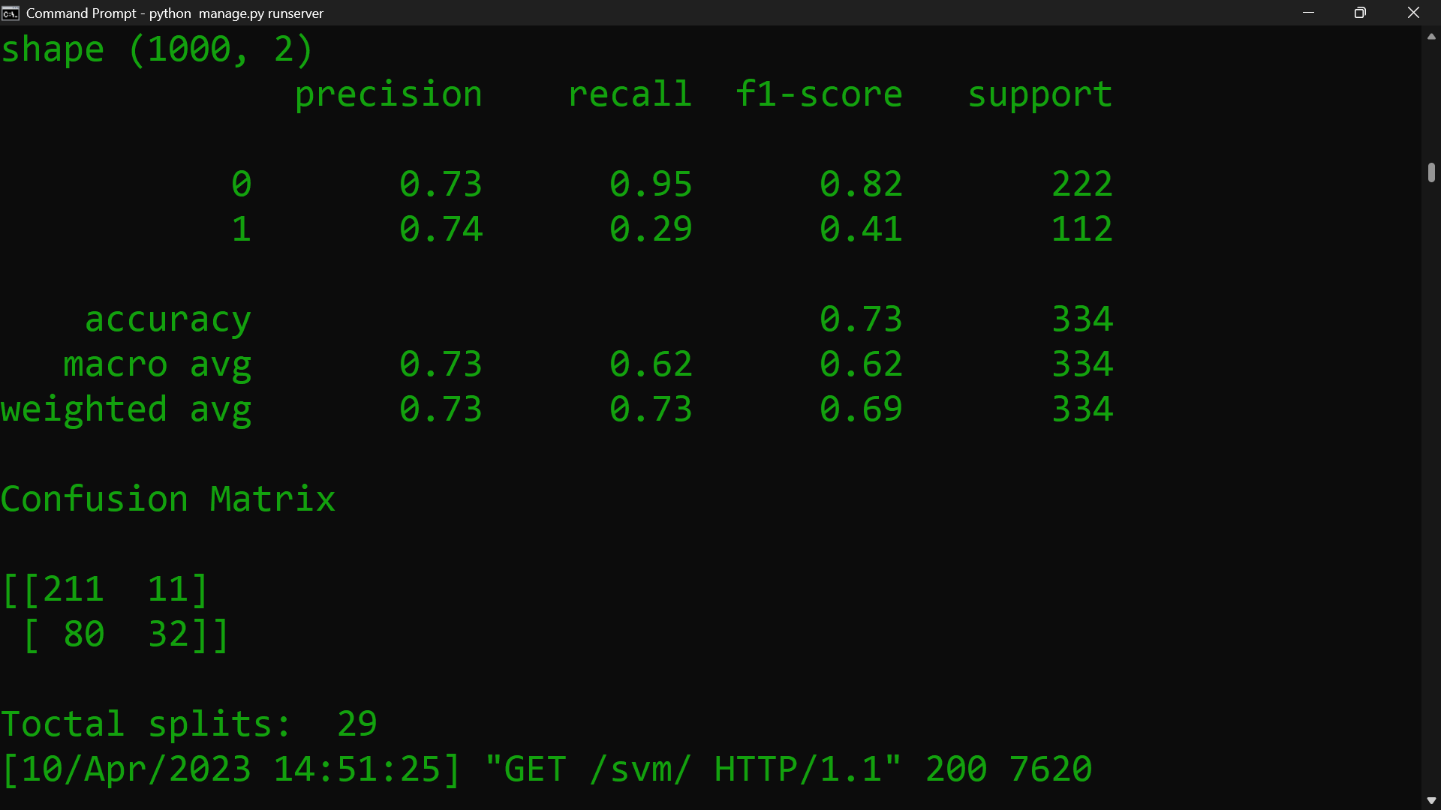
SUPPORT VECTOR ALGORITHM

Slide 24
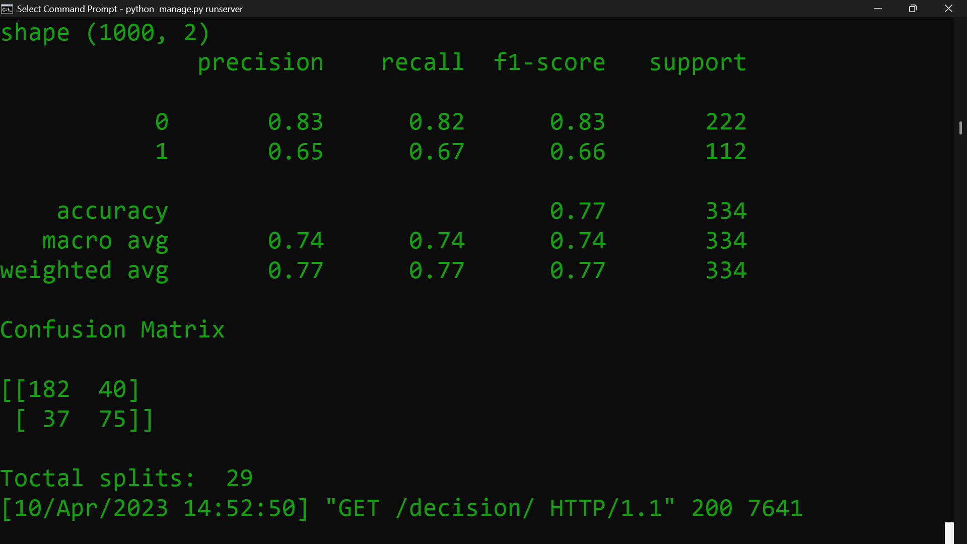
DECISION TREE BASED METHOD

Slide 25
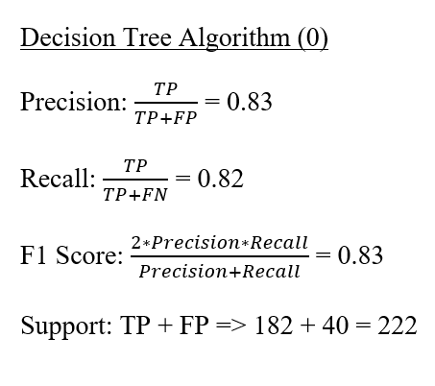
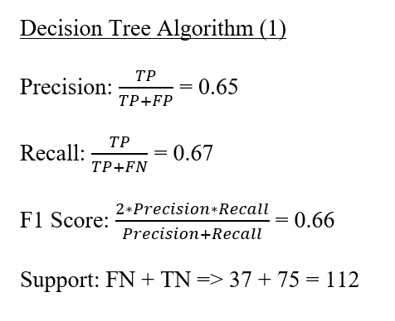
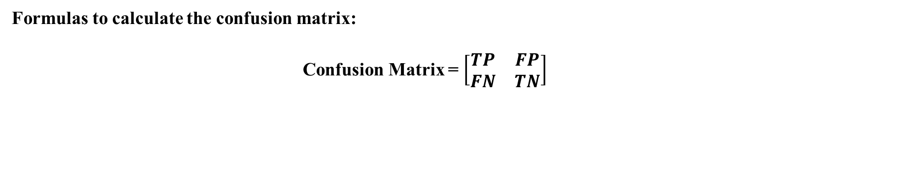
Formulas to calculate the confusion matrix:
Confusion Matrix = $\left[\begin{matrix}TP & FP \\ FN & TN\end{matrix}\right]$
Accuracy: $\frac{TP+TN}{TP+TN+FP+FN}$ = 0.77

Slide 26
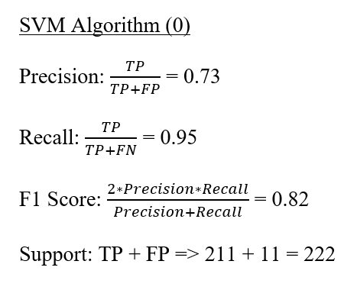
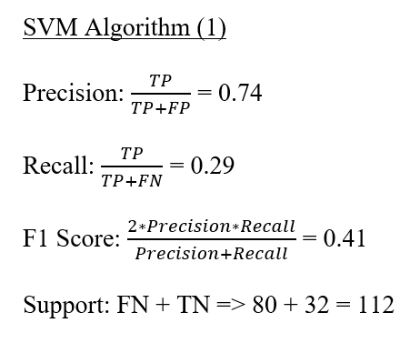
Accuracy: $\frac{TP+TN}{TP+TN+FP+FN}$ = 0.73

Slide 27
Conclusion

Slide 28
CONCLUSION
This reviews the main methods of machine learning, and summarizes several representative applications after understanding the history of machine learning in the medical field and its current application. The typical ideas and algorithms are summarized. At the same time, the improvement method based on machine learning in the process of visiting is proposed.
However, this does not mean that ML is perfect. Whether in terms of technology, ethic or law, it has certain problems. The solution of these problems requires technicians and legal personnel. Working together, and how to strike a balance between manpower and machine is also a problem that everyone of us must face.

Slide 29
Future Work

Slide 30
Some of the benefits machine learning applications in healthcare can bring health professionals:
Improving diagnosis : ML in healthcare can be used to develop better diagnostic tools to analyse medical images.
For example, a machine learning algorithm can be used in medical imaging using pattern recognition to look for patterns that indicate a particular disease.
Reducing costs : ML can be used to improve the efficiency of healthcare, which could lead to cost savings.
For example, machine learning in healthcare could be used to develop better algorithms for managing patient records or scheduling appointments. This could potentially help to reduce the amount of time and resources that are wasted on repetitive tasks in the healthcare system.
Improving care : ML in healthcare can also be used to improve the quality of patient care.
For example, deep learning algorithms could be used to develop systems that proactively monitor patients and provide alerts to medical devices or electronic health records when there are changes in their condition.

Slide 31
References

Slide 32
REFERENCES
[1] G. Eason, B. Noble, and I.N. Sneddon, “On certain integrals of Lipschitz-Hankel type involving products of Bessel functions,” Phil. Trans. Roy. Soc. London, vol. A247, pp. 529-551, April 1955. (references)
[2] Jiang M, Zhang S, Huang J, et al. Scalable histopathological image analysis via supervised hashing with multiple features[J]. Medical Image Analysis, 2016, 34:3-12.
[3] Joanna J K, Pawel K . Automatic Classification of Specific Melanocytic Lesions Using Artificial Intelligence[J]. BioMed Research International, 2016, 2016:1-17.
[4] Lu-Cheng, Zhu,Yun-Liang, Ye,Wen-Hua, Luo,Meng, Su,Hang-Ping, Wei,Xue-Bang, Zhang,Juan, Wei,Chang-Lin, Zou.A model to discriminate malignant from benign thyroid nodules using artificial neural network.[J].PloS one,2013,8(12):e82211.
[5] Huang W C , Chang C P . Automatic Nasal Tumour Detection by grey prediction and Fuzzy C-Means clustering[C]// IEEE International Conference on Systems. IEEE, 2006.M. Young, The Technical Writer’s Handbook. Mill Valley, CA: University Science, 1989.

Slide 33


